Slide 1
Diabetes
Diabetes is a chronic disease that occurs when your blood glucose, also called blood sugar, is too high. Glucose is your body's main source of energy. Insulin, a hormone produced by the pancreas, helps your body use glucose for energy.
There are three main types of diabetes:
Type 1 diabetes: This type is an autoimmune disease in which your immune system attacks and destroys the cells in your pancreas that make insulin.
Type 2 diabetes: This type is the most common form of diabetes. With type 2 diabetes, your body doesn't make enough insulin or your body's cells don't respond normally to insulin (insulin resistance).
Gestational diabetes: This type of diabetes develops in some women during pregnancy. It usually goes away after the baby is born, but women who have had gestational diabetes are at an increased risk of developing type 2 diabetes later in life.
Symptoms of diabetes
The symptoms of diabetes can vary depending on the type and severity of the disease. Some common symptoms include:
Increased thirst
Frequent urination
Feeling tired
Blurred vision
Slow-healing sores
Weight loss

Slide 2
Problem Statement
Diabetes, a chronic metabolic disorder, poses a significant public health challenge worldwide. The aim of this Diabetes Risk Detection project is to discern the key factors contributing to diabetes risk, ultimately enabling the development of a predictive model. Addressing the following inquiries will guide the analysis:
Gender Disparities in Diabetes Prevalence: Determine which gender exhibits the highest prevalence of diabetes in the dataset, providing insights into potential gender-specific risk factors.
Age-Dependent Gender Disparities: Investigate how the likelihood of developing diabetes varies with age across genders, unveiling age-specific patterns that may inform targeted prevention strategies.
Hypertension as a Diabetes Risk Factor: Explore the relationship between hypertension and diabetes, assessing whether individuals with hypertension face an elevated risk of developing diabetes.
Impact of Heart Attack on Diabetes Risk: Examine the association between a history of heart attack and the risk of developing diabetes, providing valuable insights for both cardiovascular and diabetes risk management.
Combined Effects of Hypertension and Heart Attack: Analyze how the coexistence of hypertension and a history of heart attack influences the overall risk of developing diabetes, informing comprehensive risk assessment strategies.
Link Between Smoking and Diabetes: Investigate the potential correlation between smoking and diabetes risk, shedding light on lifestyle factors that may contribute to diabetes development.
Role of Hemoglobin in Diabetes: Quantify the impact of hemoglobin levels on diabetes risk, elucidating the role of this hematological marker in predicting and managing diabetes.
Blood Glucose Levels and Diabetes Relationship: Explore the relationship between blood glucose levels and the risk of developing diabetes, providing critical insights into glucose regulation as a risk factor.
BMI and Diabetes Association: Investigate the relationship between Body Mass Index (BMI) and diabetes risk, offering valuable information for weight management and diabetes prevention.
Predictive Model Development: Develop a robust predictive model to assess an individual's risk of developing diabetes, leveraging the identified risk factors for early intervention and personalized preventive measures.

Slide 3
This project is poised to benefit a range of stakeholders:
Individuals: Empower individuals to assess their diabetes risk and adopt proactive measures for risk reduction.
Healthcare Providers: Equip healthcare providers with a predictive model to identify patients at risk, enabling early intervention and personalized preventive strategies.
Public Health Officials: Provide insights for public health officials to develop and implement targeted programs at the population level, aiming to prevent and manage diabetes effectively.

Slide 4
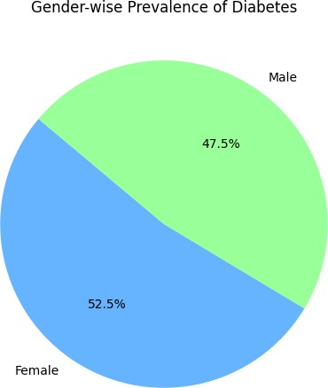
Gender has the highest prevalence of diabetes
Gender with highest prevalence of diabetes: Female
Gender has a higher chance of developing diabetes, and how does this vary with age

Slide 5
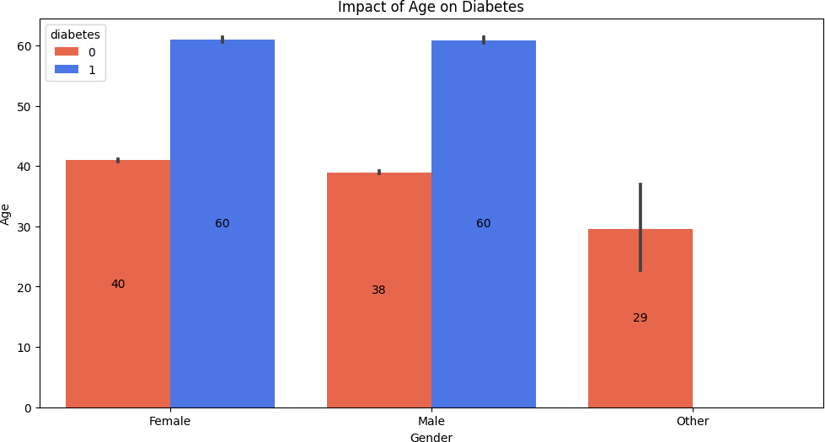
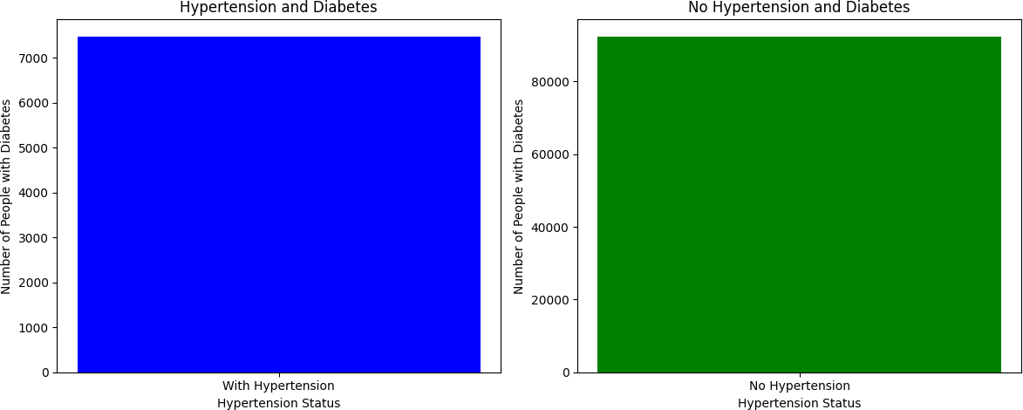
The figure above shows that if any gender crosses the age of 40, especially males and females, the risk of diabetes increases. However, it also depends on other factors as well.
hypertension increase the risk of developing diabetes
Number of people with hypertension who developed diabetes: 7479 Number of people without hypertension who developed diabetes: 92455
here is no strong relationship between hypertension and diabetes. The above figure shows that having no hypertension does not necessarily mean that one does not have diabetes. The data

Slide 6
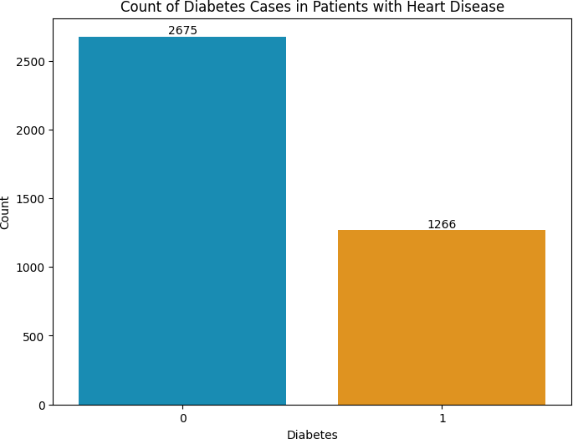
indicates that diabetes does not depend on the presence of hypertension. Now let's determine whether there is a relationship between heart diseases and diabetes.
heart attack increases a person's risk of developing diabetes?
The figure shows a total of 3941 heart patients, of which 1266 have diabetes and 2675 do not have diabetes.
Similar to hypertension, there is no strong relationship between heart disease and diabetes. Diabetes can occur regardless of whether a person has heart disease or not, as it depends on other factors.
hypertension and a heart attack impact the risk of developing diabetes

Slide 7
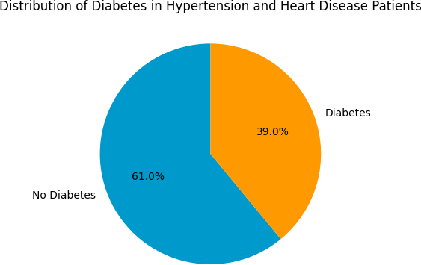
The pie chart shows that if a person has both hypertension and heart disease, they have a 39% chance of also having diabetes. If they do not have diabetes, they have a 61% chance.
Let's analyze the diabetes gender wise in people with both hypertension and heart disease

Slide 8
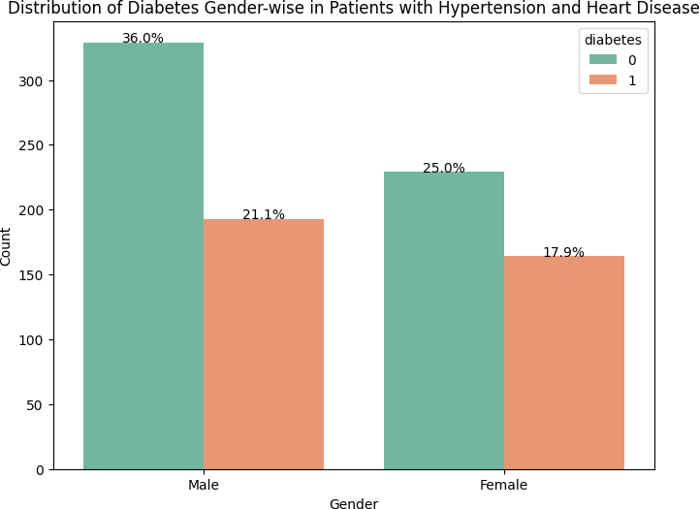
The above figure shows that 21% of males and 17.9% of females who have both hypertension and heart disease also have diabetes.
link between smoking and diabetes

Slide 9
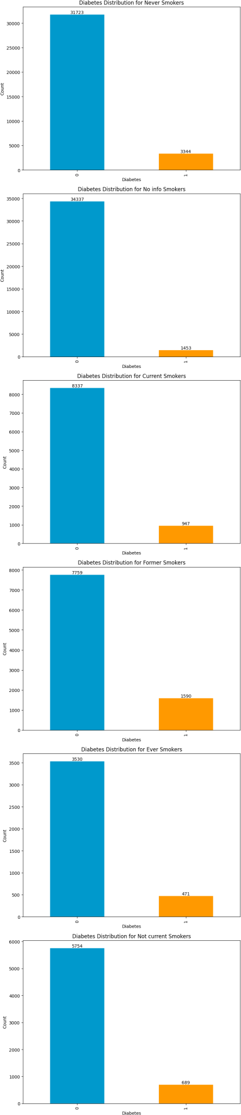

Slide 10
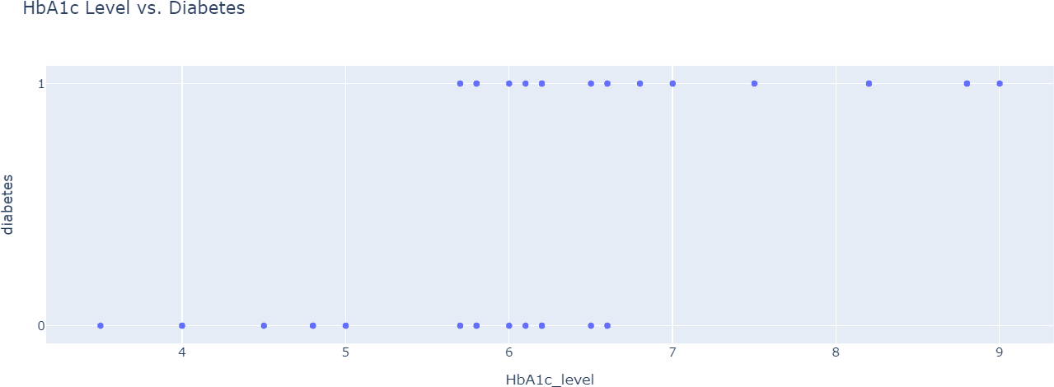
People who never smoke have diabetes counts of 3344, and 31723 people who never smoke do not have diabetes.
People with diabetes count 1453, and 34337 people without diabetes do not have information about whether or not they have diabetes.
People who currently smoke have diabetes counts of 947, and 8337 people who currently smoke do not have diabetes.
People who have ever smoked have diabetes counts of 471, and 3530 people who have ever smoked do not have diabetes.
People who never smoke have diabetes counts of 689, and 5754 people who never smoke do not have diabetes.
Hemoglobin Impact at Diabetes
Minimum HbA1c Level: 3.5 Maximum HbA1c Level: 9.0
Mean HbA1c Level: 5.527447115095963

Slide 11
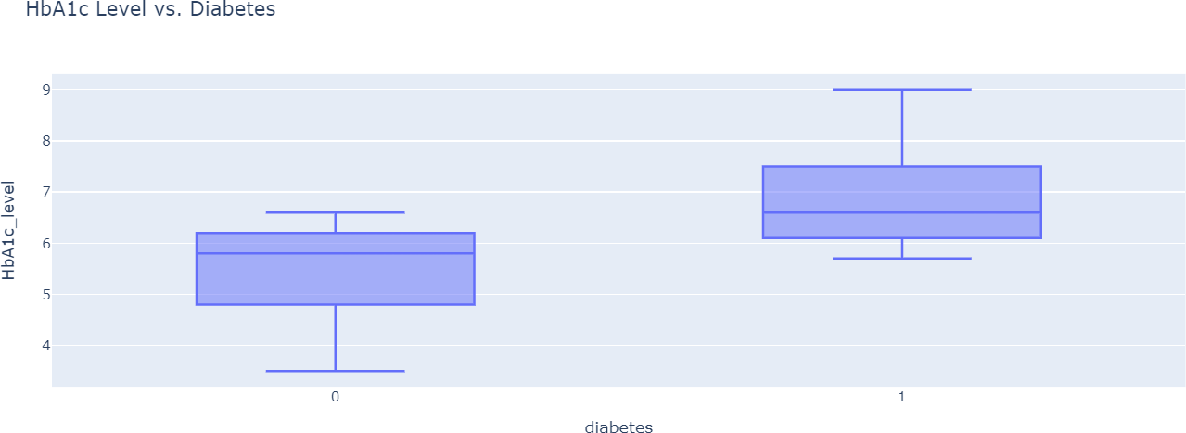
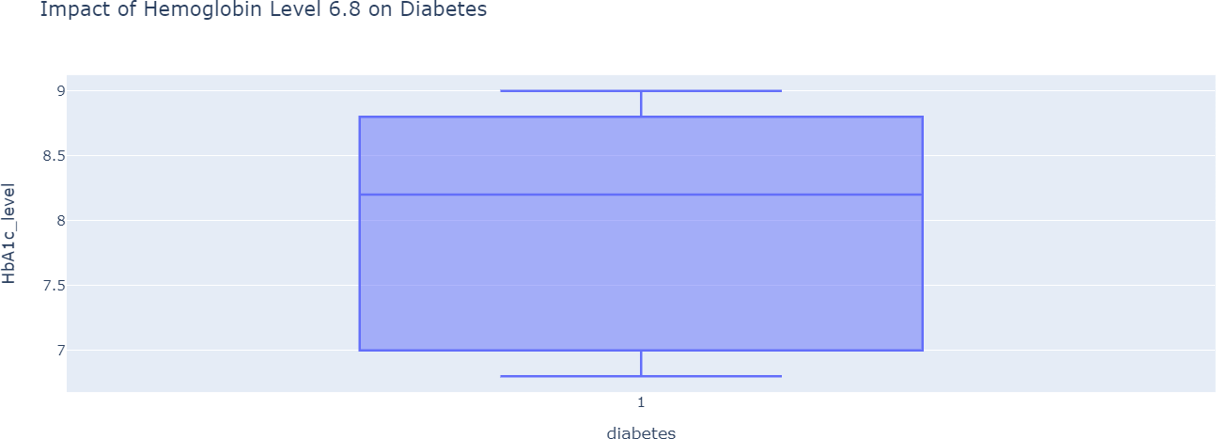
There is a significant relationship between hemoglobin and diabetes. The above figure indicates that a hemoglobin level ranging from 4.8 to 6.2 is considered healthy. However, if a person has an HbA1c level higher than 6.1, it could be considered risky. There are many people with a hemoglobin level lower than 6.8 who have diabetes, potentially due to their high glucose levels. However, diabetes risk also depends on other factors. There is a high chance of diabetes risk. To verify this relationship, let's create a box plot. Additionally, let's create another dataframe that specifically includes individuals with an HbA1c level greater than or equal to 6.8, enabling us to analyze the associated diabetes risk.
The above figure indicates that if the hemoglobin level is greater than 6.8, there is a high likelihood of diabetes risk based on the data. now let's check the the relation between blood glucose level with diabetes.
Relation Between Diabetes and Blood Glucose

Slide 12
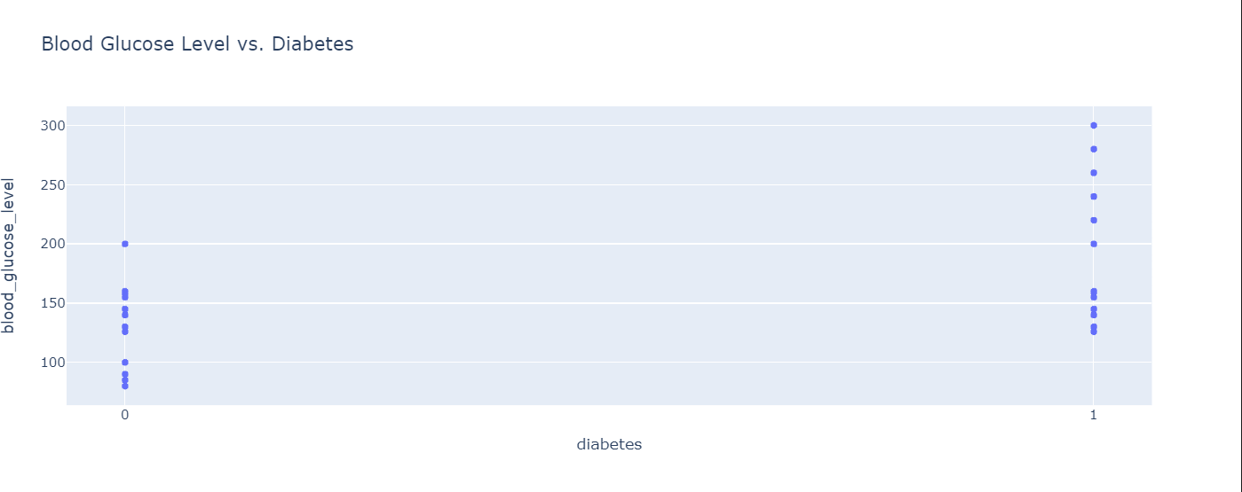
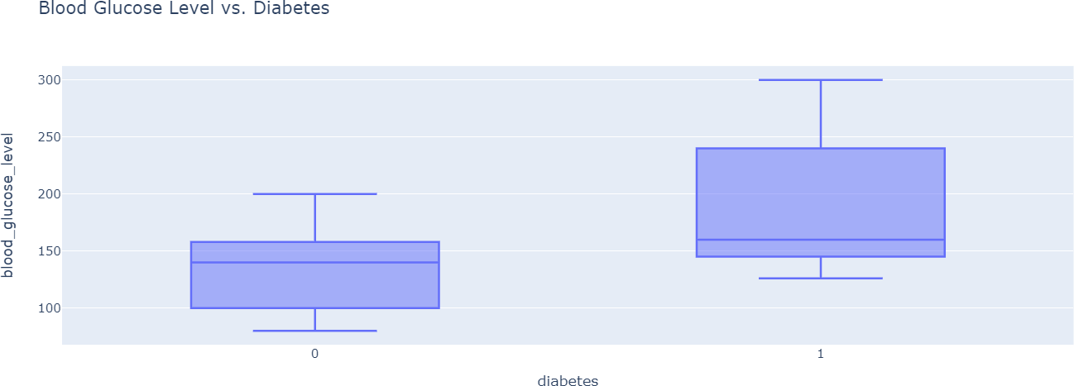
minimum level of blood Glucose 80
maximum level of blood Glucose 300
Average level of blood Glucose 138.0551864230392
We can observe a significant relationship between blood glucose levels and diabetes. The figure shows that the range between 100 and 160 in blood glucose levels is mostly considered healthy. However, the range between 160 and above is considered risky, and when the glucose level exceeds 200, the chances of diabetes risk are very high. Now, let's create another dataframe that consists of values where the glucose level is greater than or equal to 200 and identify the number of individuals with diabetes.

Slide 13
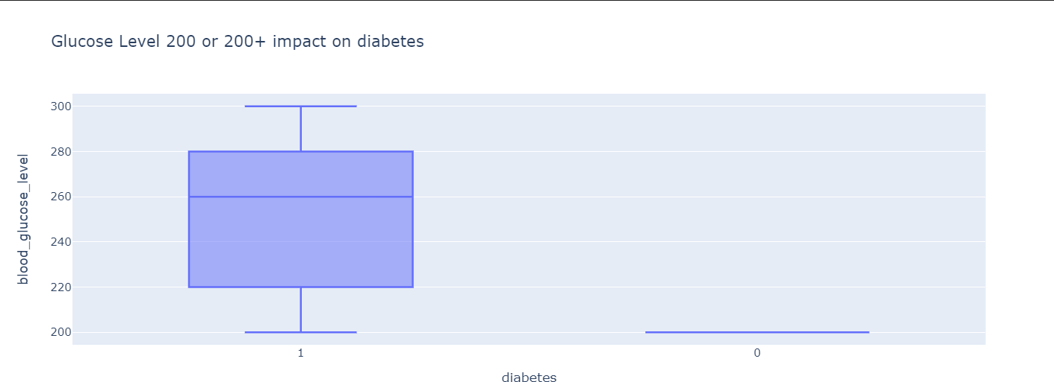
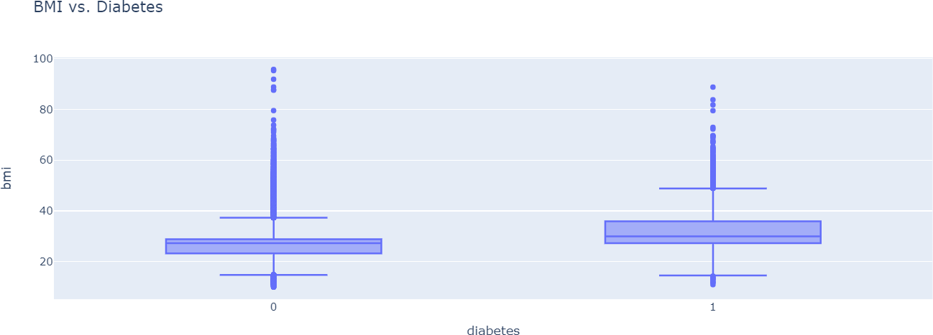
The above figure indicates that, based on the data, there are many people with a blood glucose level of 200 who do not have diabetes, likely due to their hemoglobin level being less than 6.8. Diabetes risk depends on other factors as well. Diabetic patients are most commonly found within the blood glucose level range of 220 to 280.
Relation between BMI and Diabetes
We can observe that there is no strong relationship between BMI and diabetes. If a person has a low BMI score, the risk of diabetes increases; similarly, when a person has a high BMI, the chances of diabetes risk also increase, potentially affecting both conditions.
Model Selection
We used three models, namely the decision tree classifier, random forest classifier, and logistic regression classifier, for a classification problem.

Slide 14
RandomForestClassifier:
Model Score: 0.9689298043728424
LogisticRegression:
Model Score: 0.9575724220743483
DecisionTreeClassifier:
Model Score: 0.9532195927352779
We can see that the Random Forest Classifier performs better than the other models, with a better score than the Logistic Regression Classifier and the Decision Tree Classifier.
I created a web app that can predict whether a person has diabetes or not using a random forest classifier model.

Slide 15
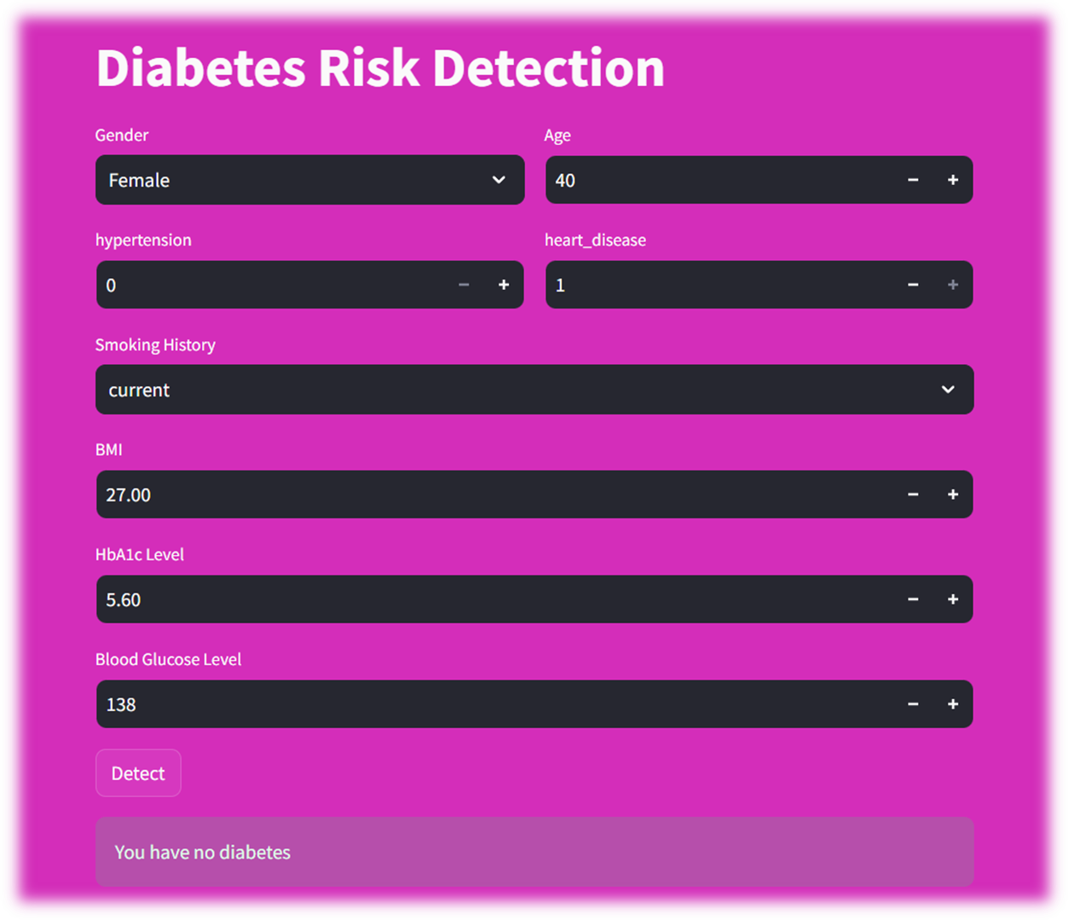
Conclusion:
the following key risk factors for diabetes can be identified:
Age: The risk of diabetes increases with age, especially after 40 years old.
Hemoglobin level: A hemoglobin level above 6.8 is a significant risk factor for diabetes.
Blood glucose level: A blood glucose level above 200 is also a significant risk factor for diabetes.
There is no strong relationship between diabetes and hypertension, heart disease, or BMI. However, people with diabetes are more likely to have these other conditions.

Slide 16
Recommendations:
To reduce your risk of diabetes, it is important to maintain a healthy weight, eat a healthy diet, and get regular exercise. You should also have your blood sugar and hemoglobin levels checked regularly. If you have any risk factors for diabetes, such as being overweight, having a family history of diabetes, or being over 40 years old, you should talk to your doctor about how to manage your risk.

